Slide 1
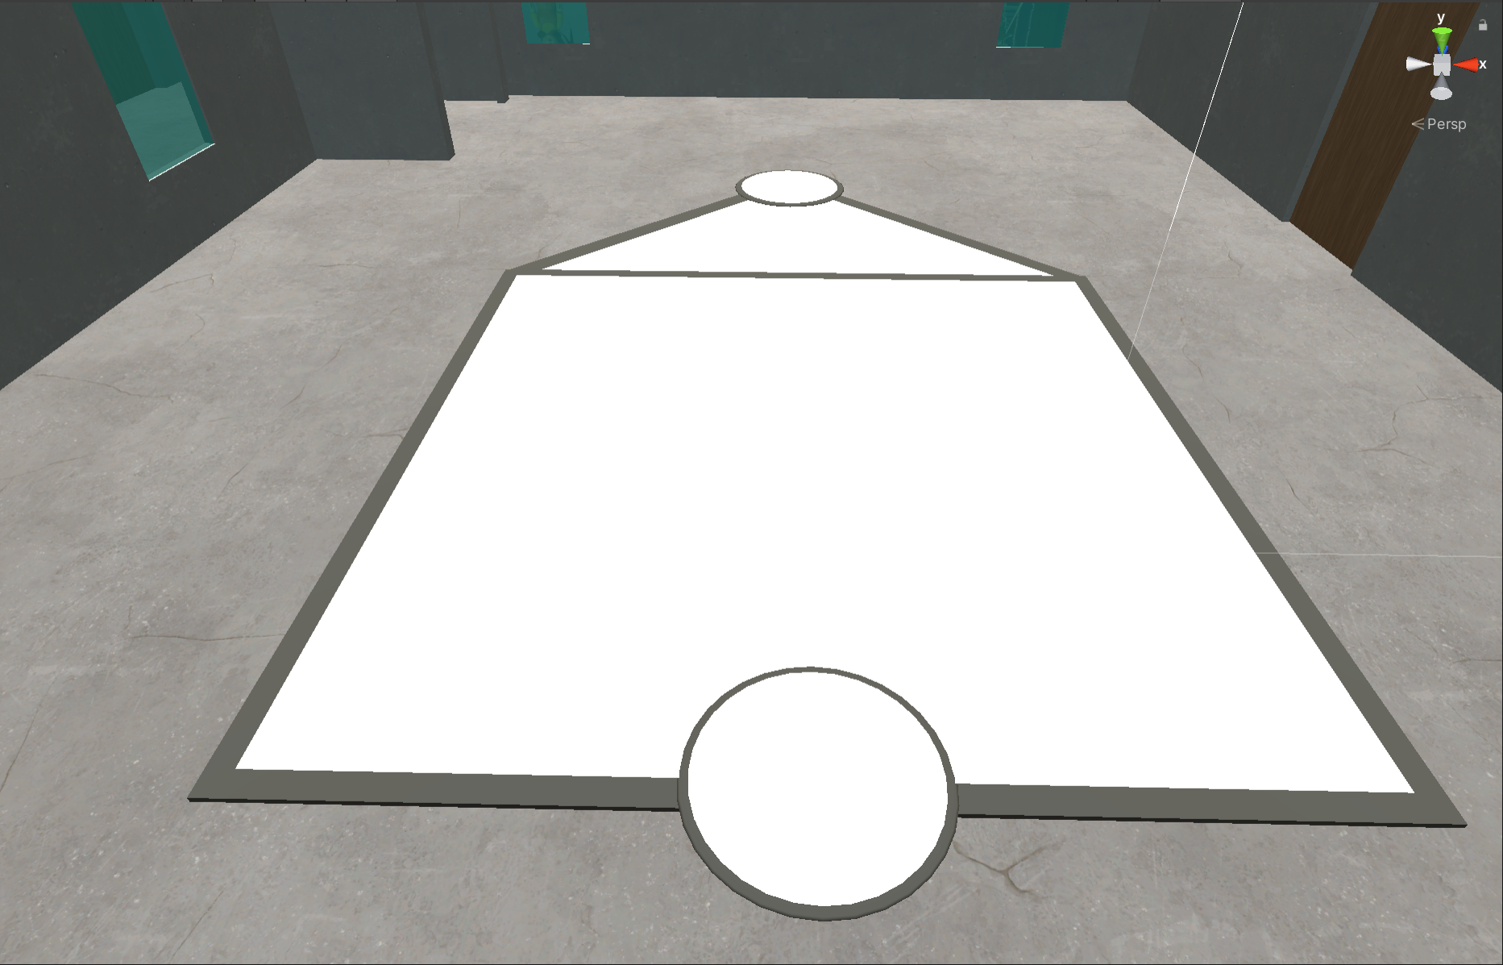
Lafferre Squid Games
Ryan Orf, Colton Sharp, Colin Smith

Slide 2
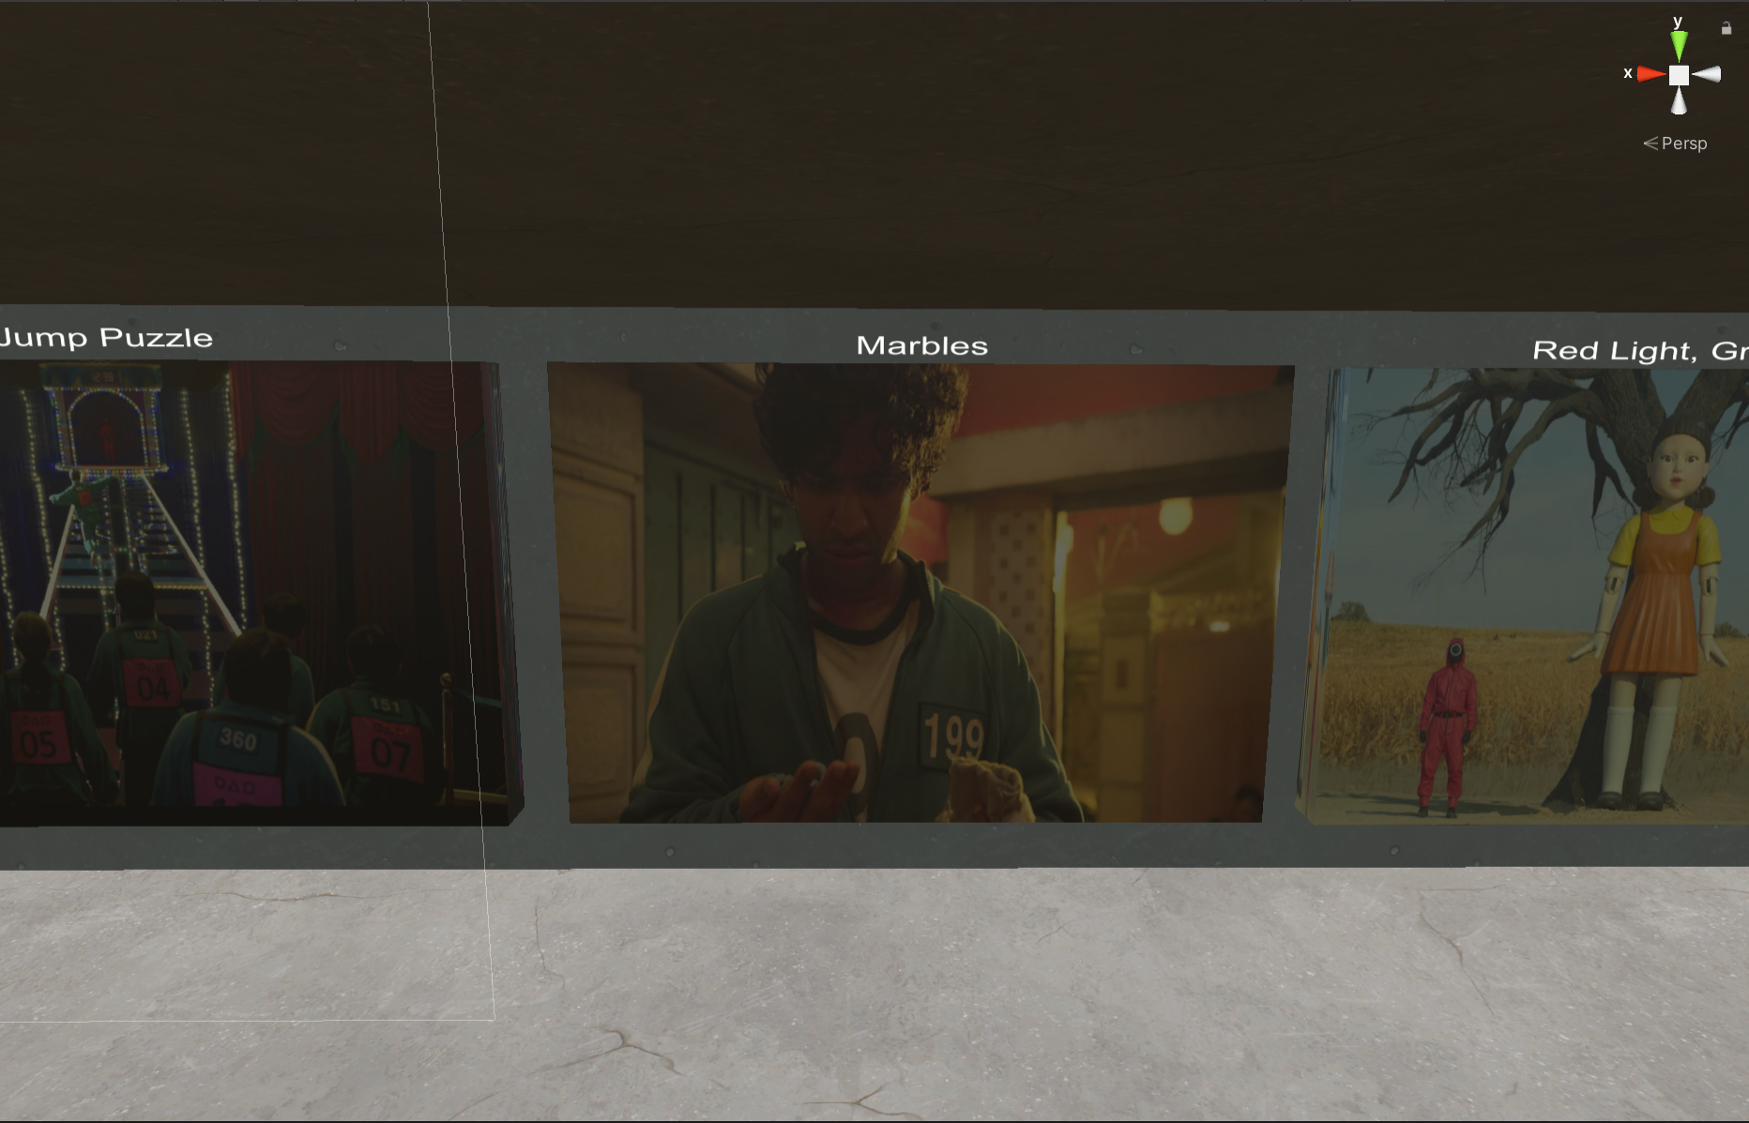
Summary
Squid Games in Lafferre!
Play Red Light Green Light, Marbles, and complete a Jump Puzzle
Games are taken from Squid Game
Games are located throughout Lafferre
Some easter eggs are hidden throughout to “shoutout” Squid Game
Characters are implemented to enhance the gaming experience
The player is able to move around using Locomotion, however there is also teleportation implementation to quickly get to games
Lafferre is detailed with many items in order to establish themes of a realistic Lafferre and Squid Game

Slide 3
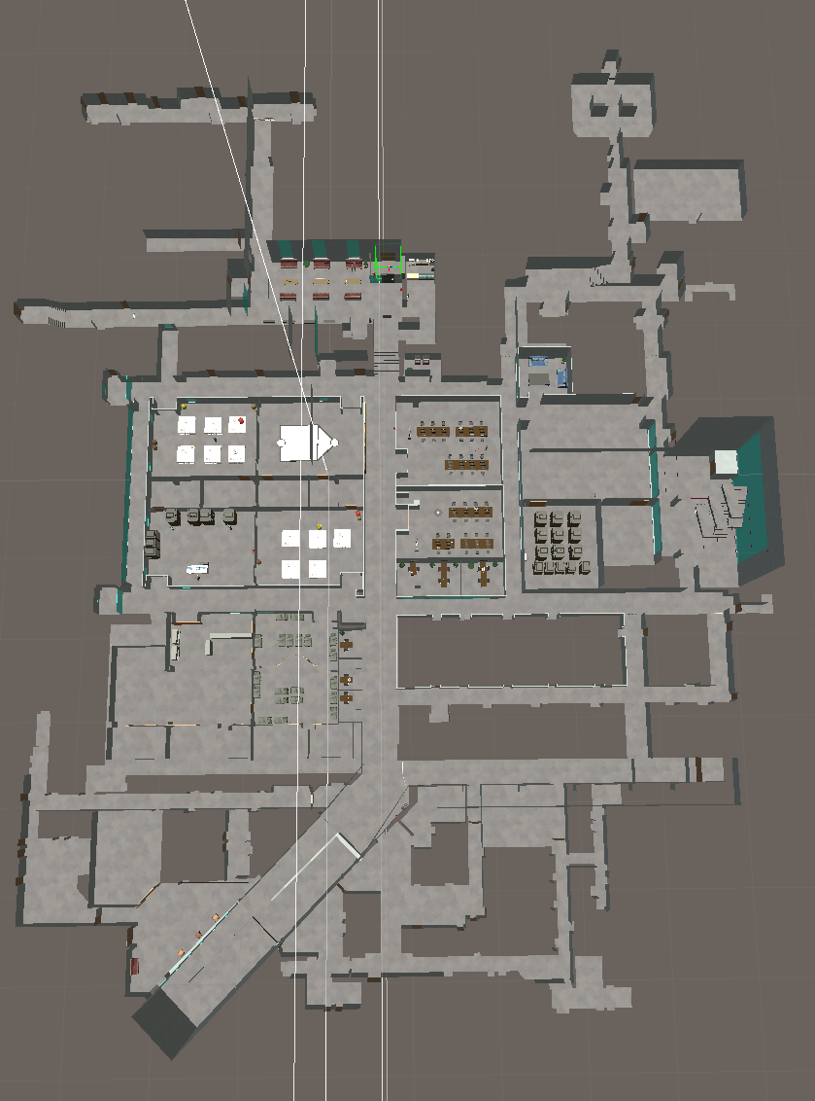
Summary of Final Product
The idea of the project was to implement games from Squid Game we were comfortable in creating, and to design Lafferre in a way to allow the user to explore a majority of the map
We created 3 of the (6) games from Squid Game
Sections to play at were placed in a way to spread the user out
Through an immersive atmosphere and deceivingly difficult challenges, we hope players can enjoy the experience, whether they choose to roam around and view familiar scenes/easter eggs or attempt to complete all 3 implemented games

Slide 4

Summary of Final Product
Some animations were placed in a way to enhance the gaming experience, or to evoke a certain emotion from some players
Red Light Green Light has animations that pay homage to the Squid Games series
Person tripping in the room with bunk beds and the Tug of War rope
Ddakji character, etc.
The video on the right shows a character dying immediately
Based on how the first person dies in the show
Elvis Presley turning around during red light
Based on the show
Text-to-speech audio plays to aid the user
Fireworks Particle System Instantiations after completing each game
…and more!

Slide 5
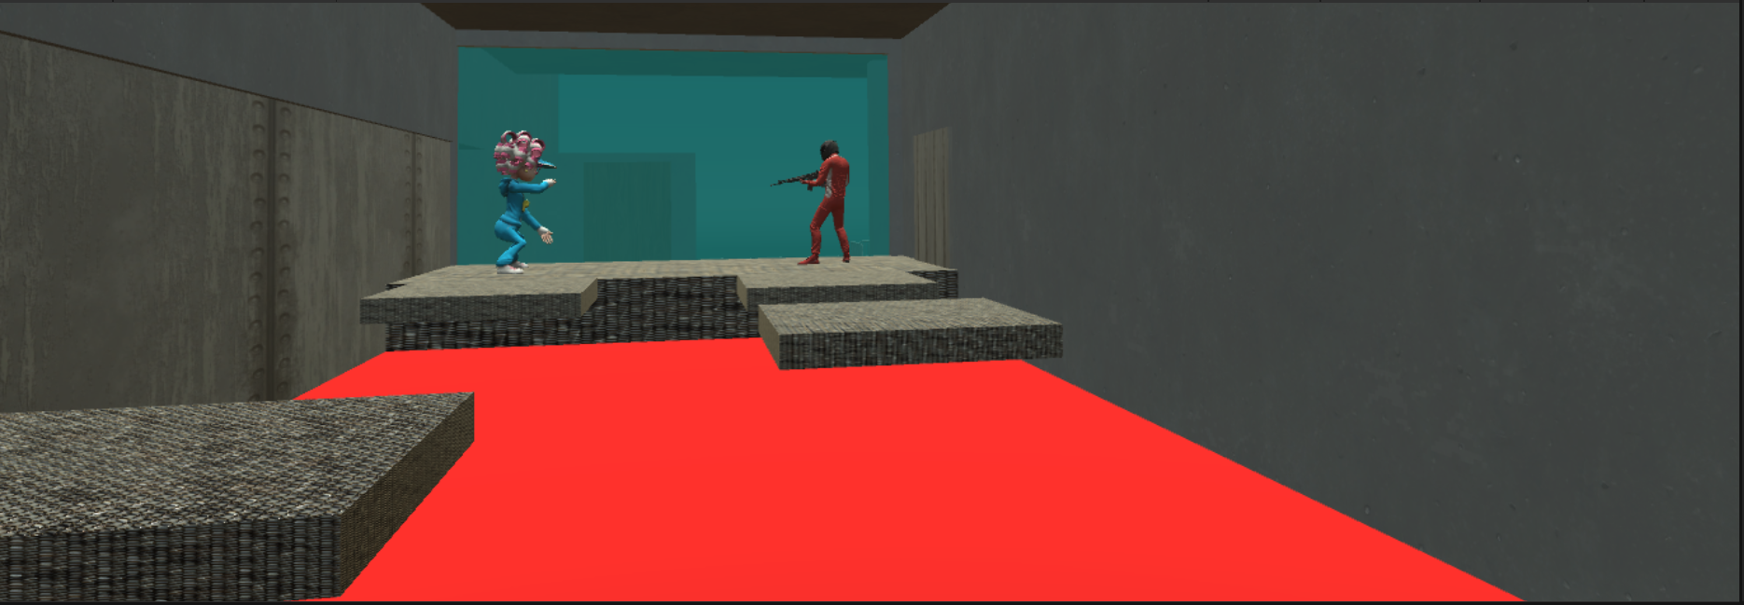
Implementation and Methods: Ryan
Front End Design: Helped implement and design certain aspects of the Front End, such as the Introduction Canvas, the grabbable easter egg objects referring to Squid Game, the position of some of the character models, and some small details such as the trophy labels
Back End Development: Instrumental in coding the functionality of the games, as well as many features such as completion status, error checking, teleportation, environmental enhancement, etc.
Animation: Responsible for creating the animations for the falling platforms in the Jump Puzzle Game

Slide 6
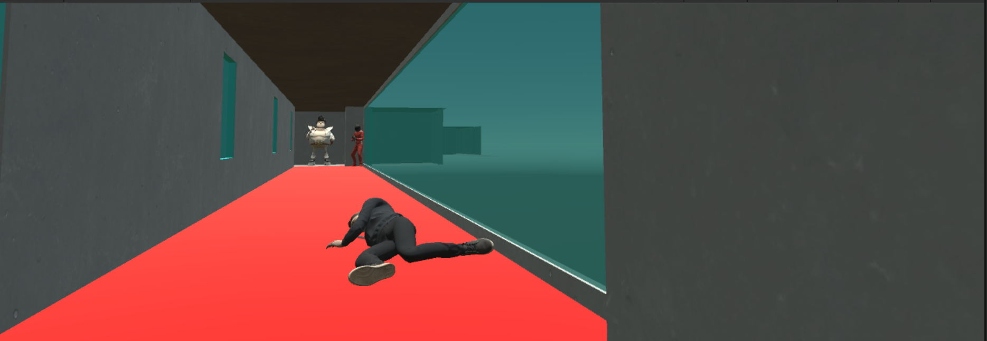
Implementation and Methods: Colton
Modeled and planned the design for Lafferre Hall. This includes rooms, games, & textures
Developed the red light green light animations. During the animation the model will face the side based on the light called.
Setup and created character animations throughout the games.
Helped with back end coding throughout the assignment.

Slide 7
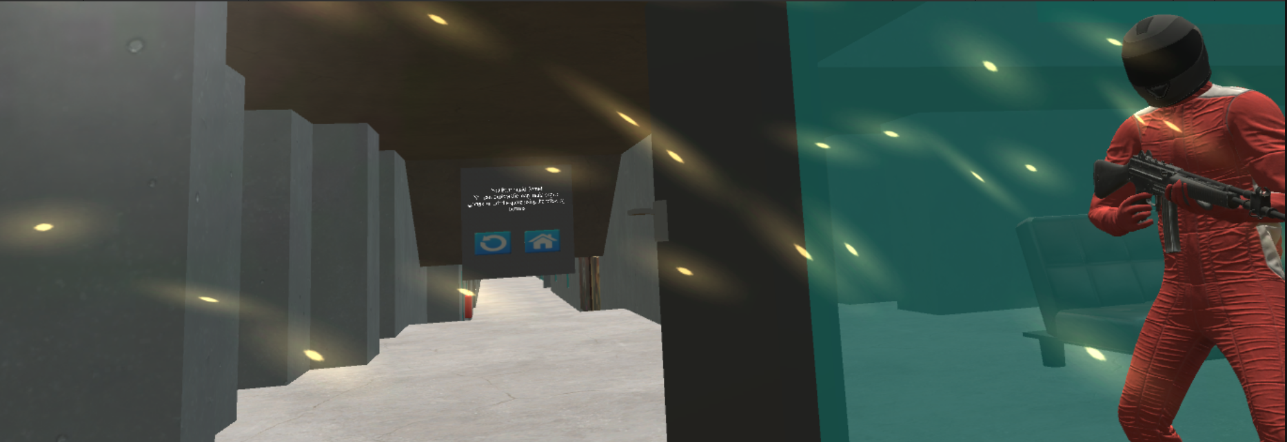
Implementation and Methods: Colin
Every canvas included myself, the menuCanvas was created by myself entirely, and I heavily influenced every other canvas
Certain features in Red Light, Green Light were made by myself
I also helped create a lot of the code
I made the animation of the opening door
I’ve made this presentation look neat as well

Slide 8
Lessons Learned
We were forced to learn a lot about how update() works and work with Scottie to make our update() efficient
Our game ran on mainly one function, which housed most of the code we used in the project
We had to set the values in the start function in order to reduce any lag we might create
Red Light, Green Light lagged our game due to generating random numbers, changing colors every few seconds, and even detecting movement
Collisions
When holding an object, sometimes the xrRig can collide with the object we hold. Additionally, some objects did not collide with the Lafferre prefab as we would have intended initially
We had to add layers and certain colliders to the object to make it only collide with the objects we wanted and in the physical ways we wanted
Next time we can add layers up front to deal with unwanted collisions between the xrRig and holdable items

Slide 9
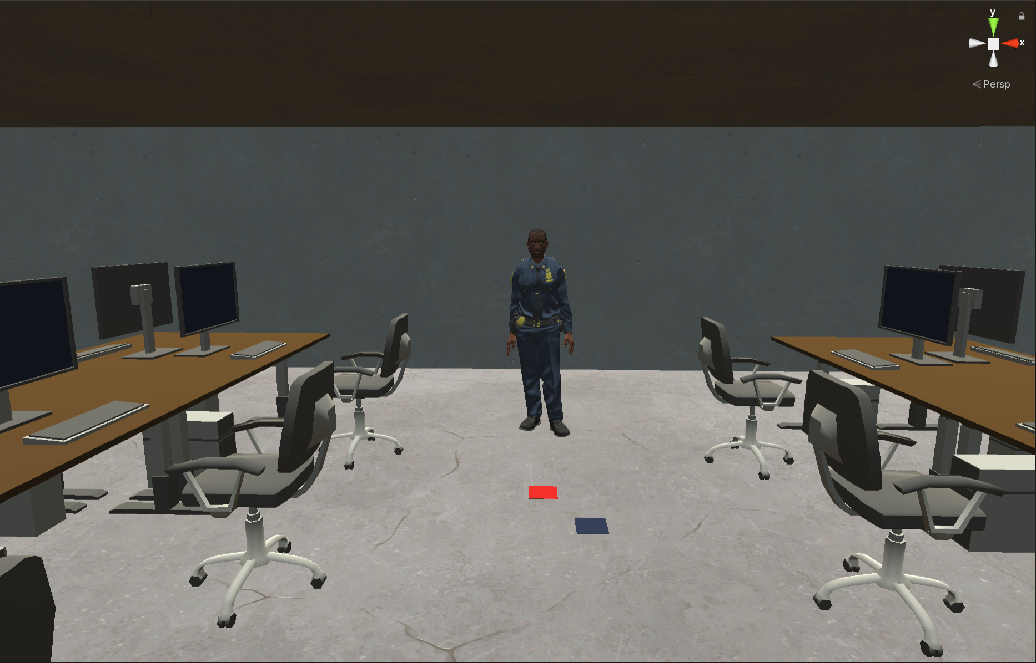
Next Steps
The game is incomplete on purpose
We didn’t have the knowledge, comfortability, and time to create all six Squid Games, as two of the other three games would require an additional user or AI
Incorporate more animations with characters, to make it seem closer to the large amount of participants in the games
Make character animations that also display the everyday bustling life in Lafferre
Expand the map even more

Slide 10
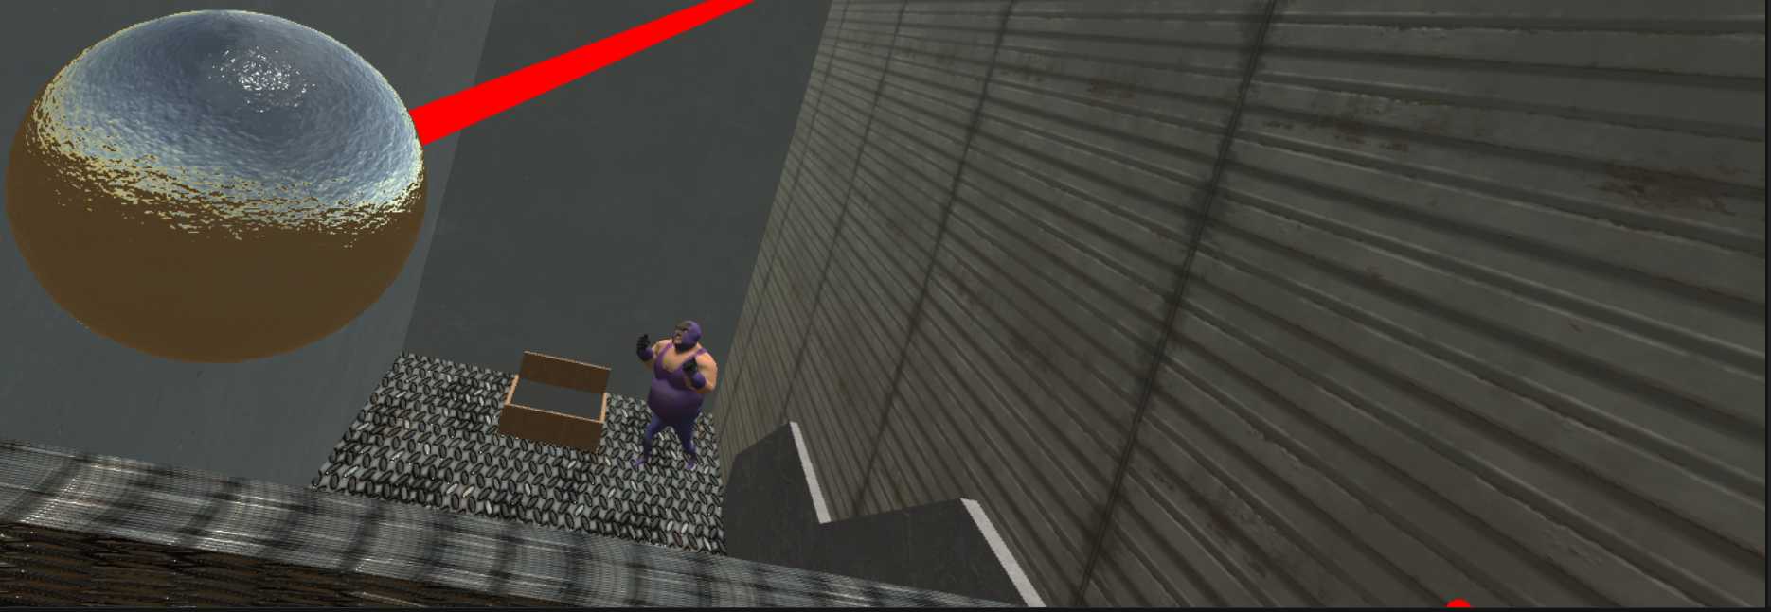
Team Roles and Responsibilities
Ryan
Coded majority of the backend for the games
Helped create most canvases, animations, and each game
Colton
Modeled almost the entirety of the building
Helped create most canvases, imported and implemented animations, and helped code
Colin
Involved in the development of every canvas
Helped download and implement character animations, code, and created the powerpoint

Slide 11
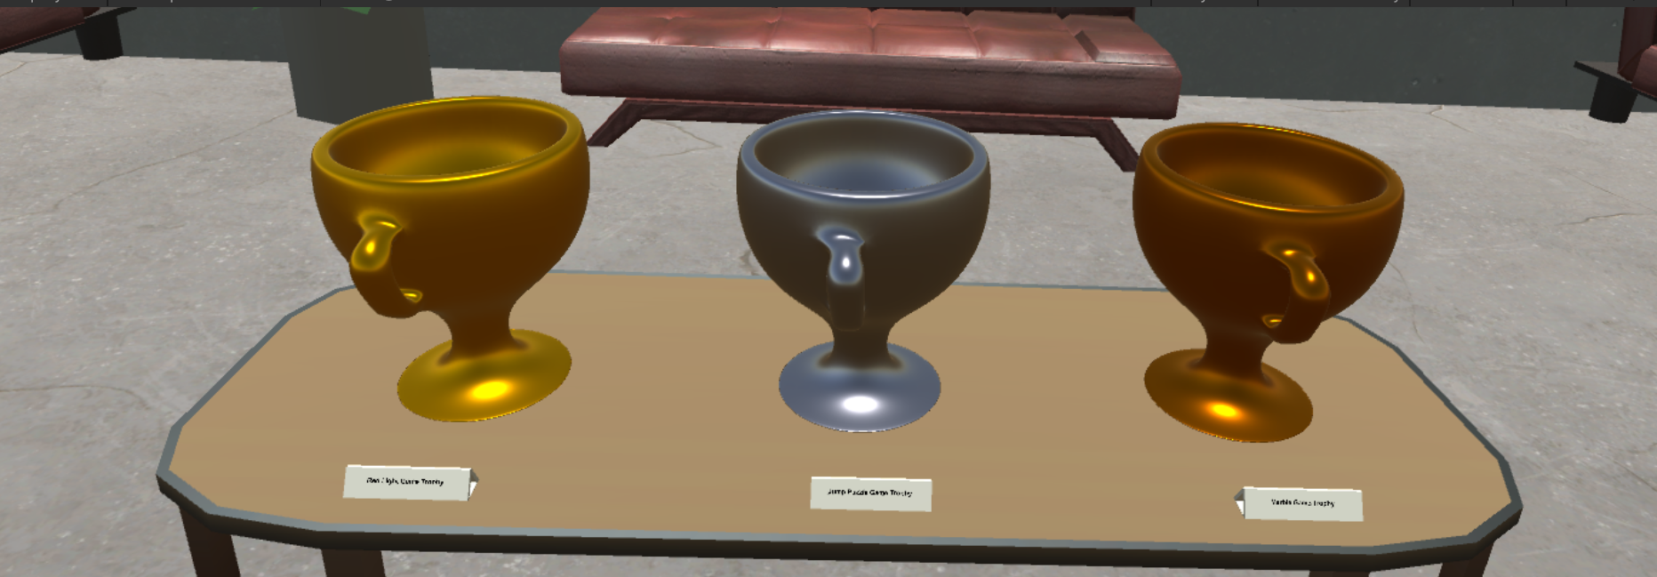
Conclusion
This is the Lafferre Squid Games
We achieved all of our goals we constructed:
Incorporate any three Squid Games
Allow the user to free roam so they are not restricted to the games
Use animations to immerse the viewer into the game
Model the building to utilize Lafferre
We believe we have created a rather fun experience that could be furthered in the future into a number of different possibilities

Slide 12
References
Squid Game (from Netflix for inspiration)
Mixamo
NaturalReadersTTS
Scottie

